Slide 1
DN1 ATAC-seq
Veronica

Slide 2

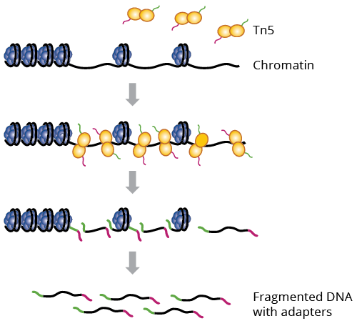
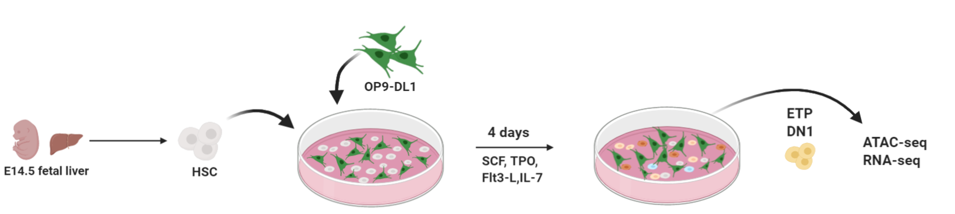
Background
?
?
Block identified with:
- FACS
- scRNA-seq
Morc3

Slide 3
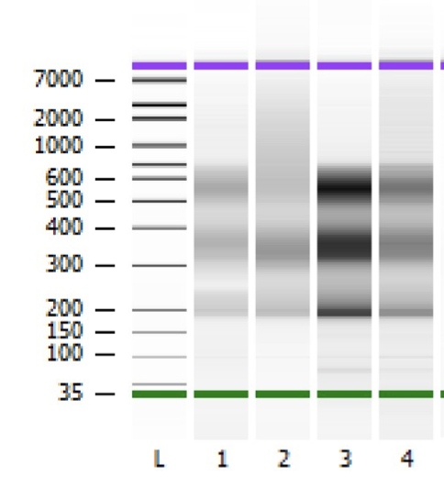
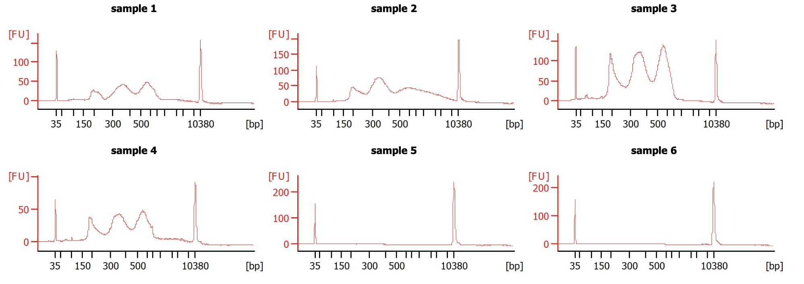
50000 DN1 cells from OP9:
2 x WT
2 x KO

Slide 4
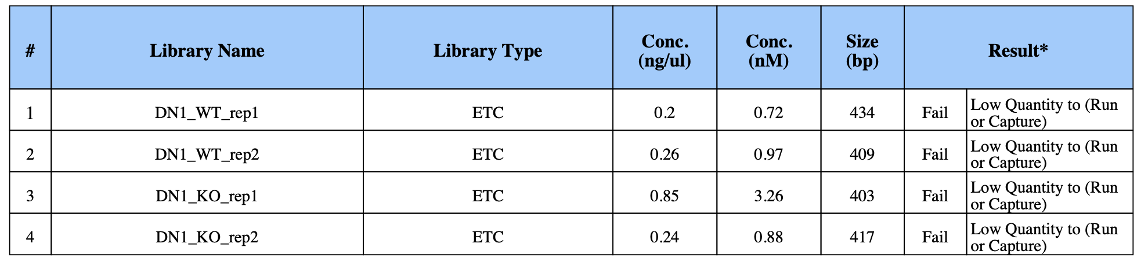
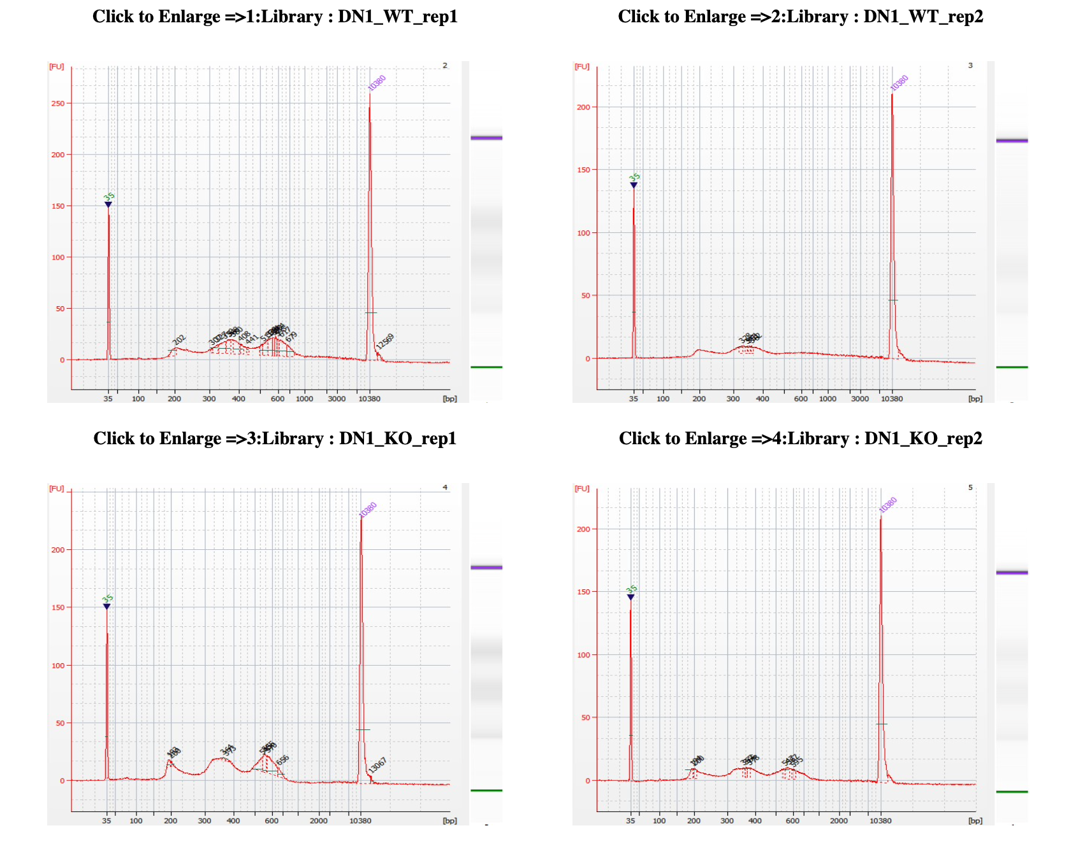

Slide 5
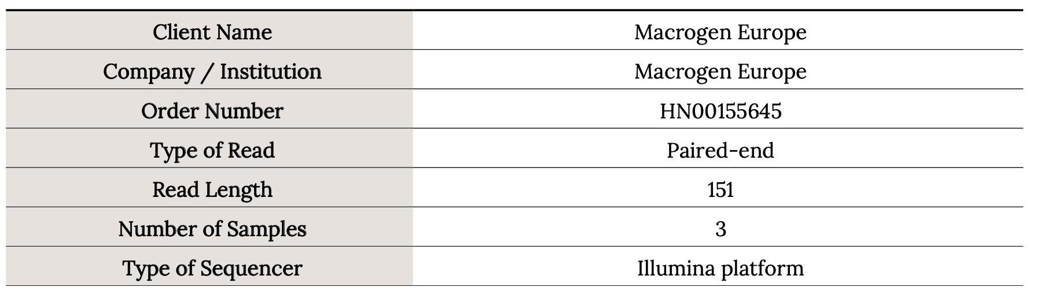
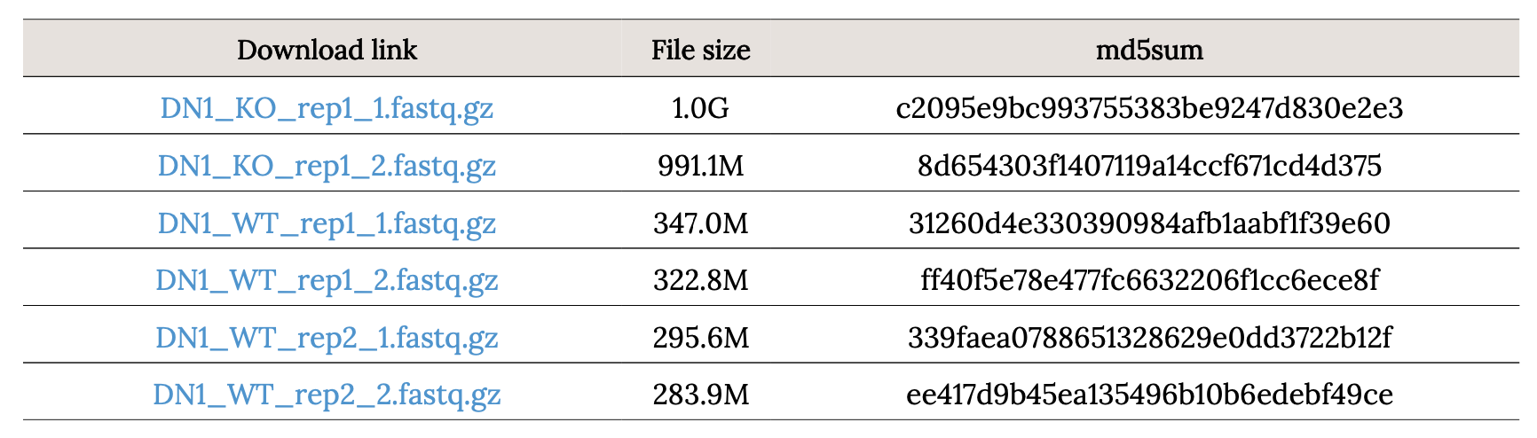
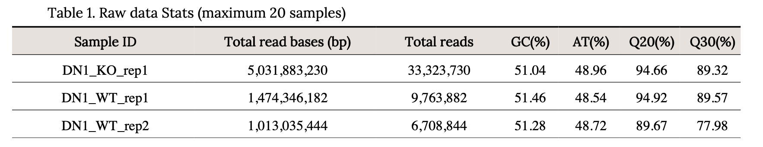
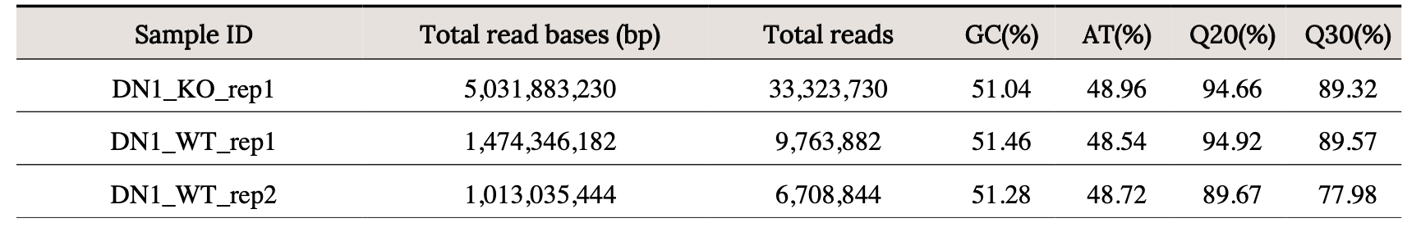
QC reports provided by Macrogen

Slide 6
Analysis
Done with our Snakemake-ATAC-seq pipeline

Slide 7
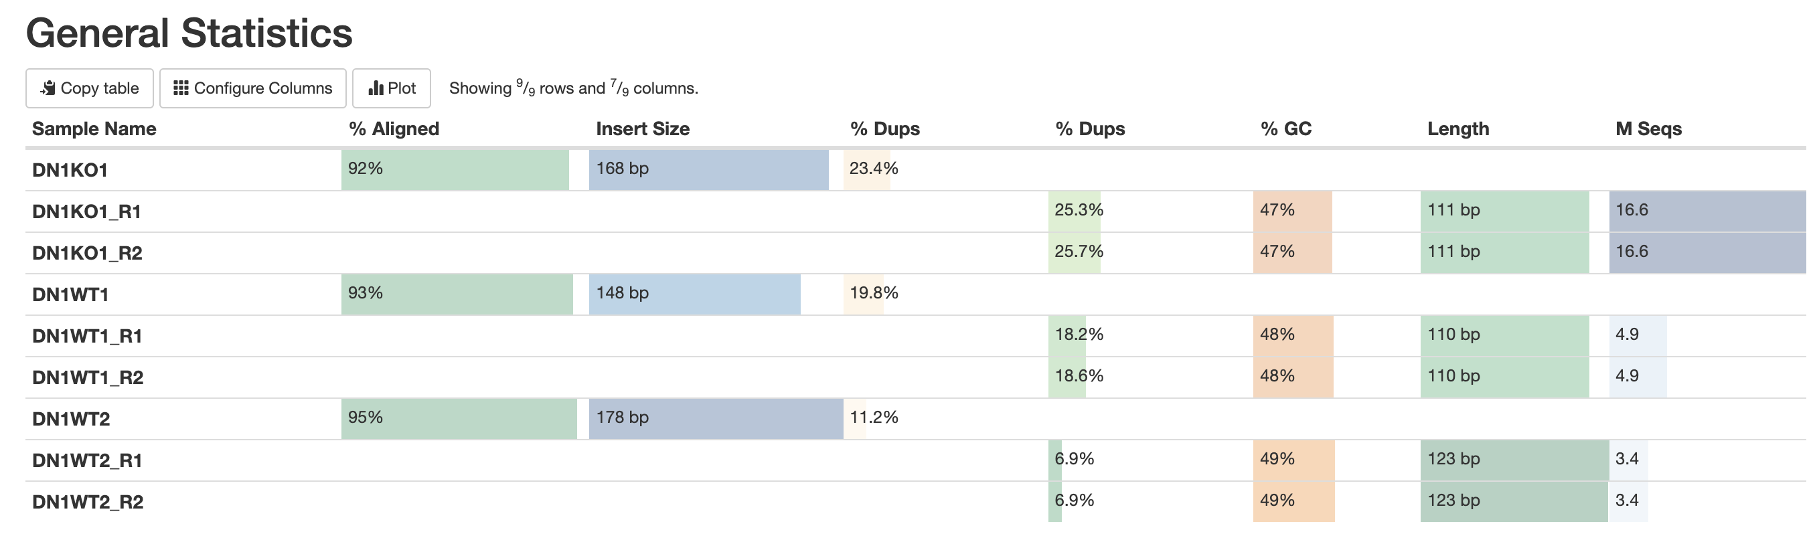
Quality controls

Slide 8
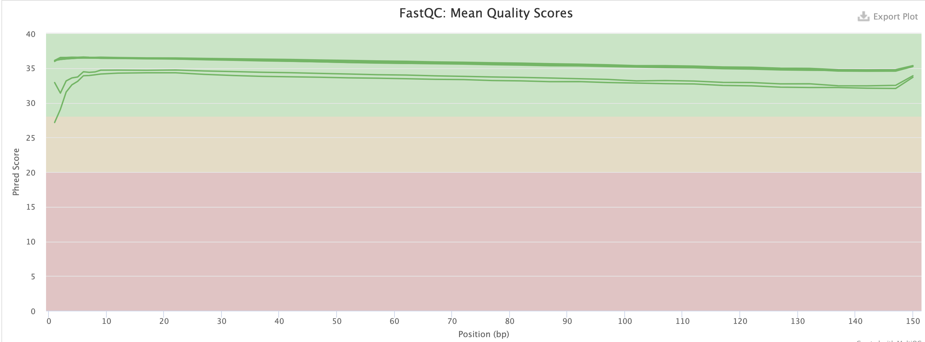
Quality controls

Slide 9
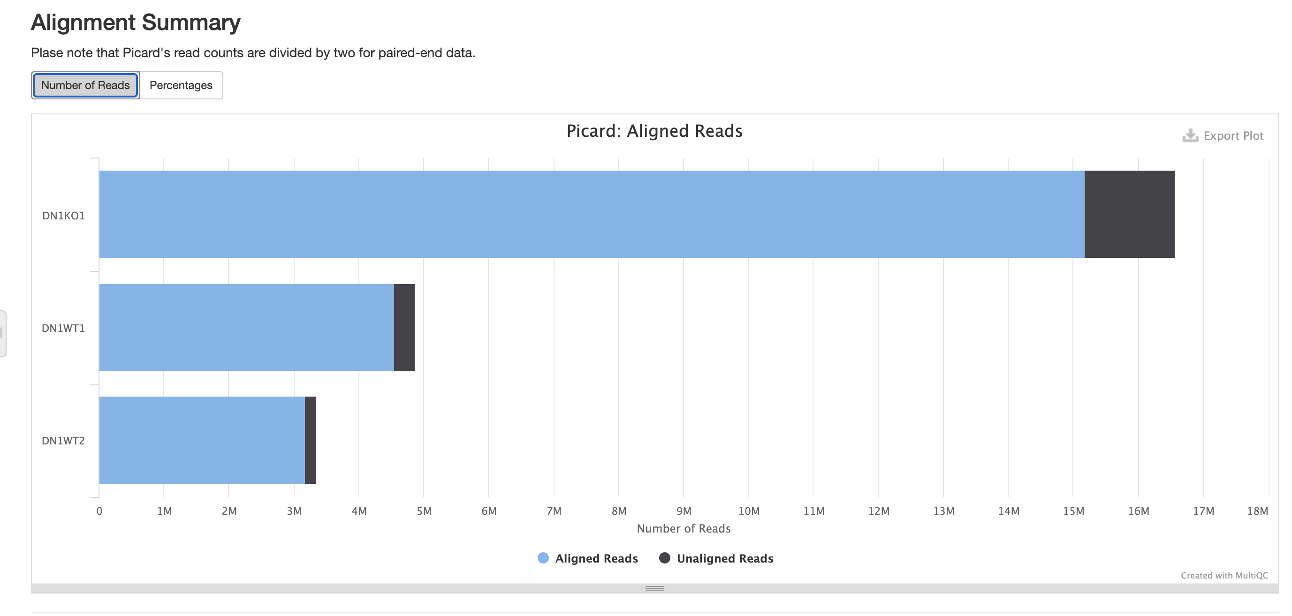
Quality controls

Slide 10
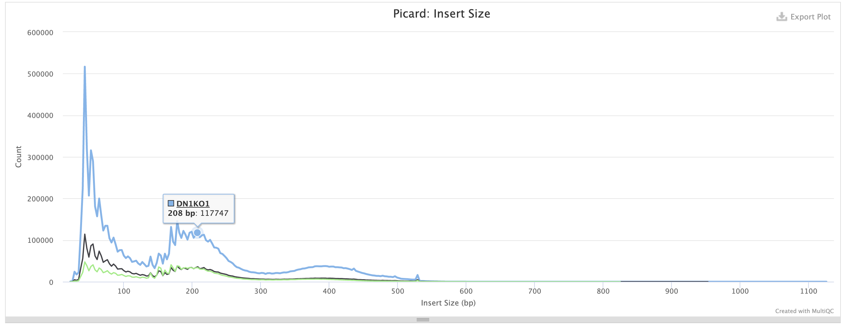

Slide 11
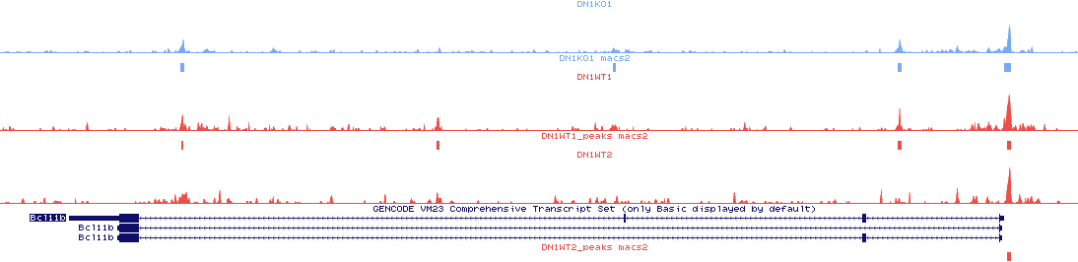
Bcl11b
500
KO
0
500
WT
0
500
WT
0
Promoter

Slide 12
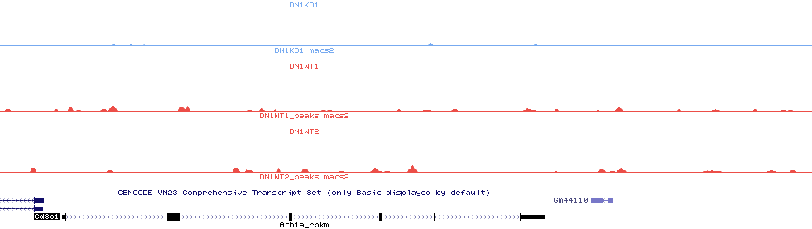
Cd8b1
500
KO
0
500
WT
0
500
WT
0

Slide 13
Peak calling: MACS2
37473
28992
24902

Slide 14
Overlap WT1 and WT2
63% of WT1 peaks overlap
with WT2
73% of WT2 peaks overlap
with WT1

Slide 15
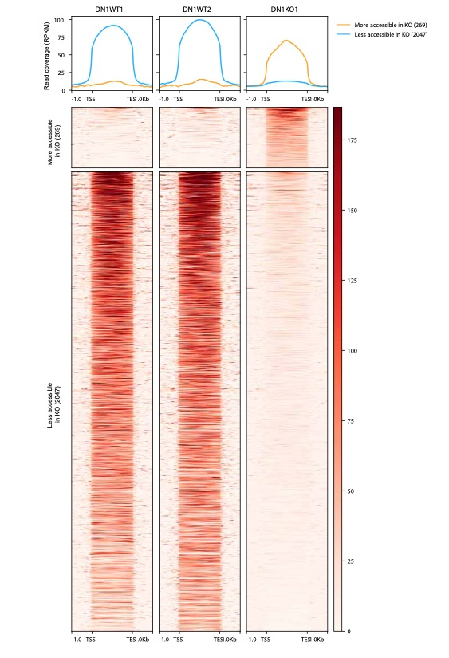
Differential peak analysis
2xWT versus 1xKO
Homer getDifferentialPeaks

Slide 16


2x DN1 analyzed
99% Aligned reads (10M reads)
Phred > 35
Samples | Peaks
ImmgenWT1 | 58066
ImmgenWT2 | 42862

Slide 17
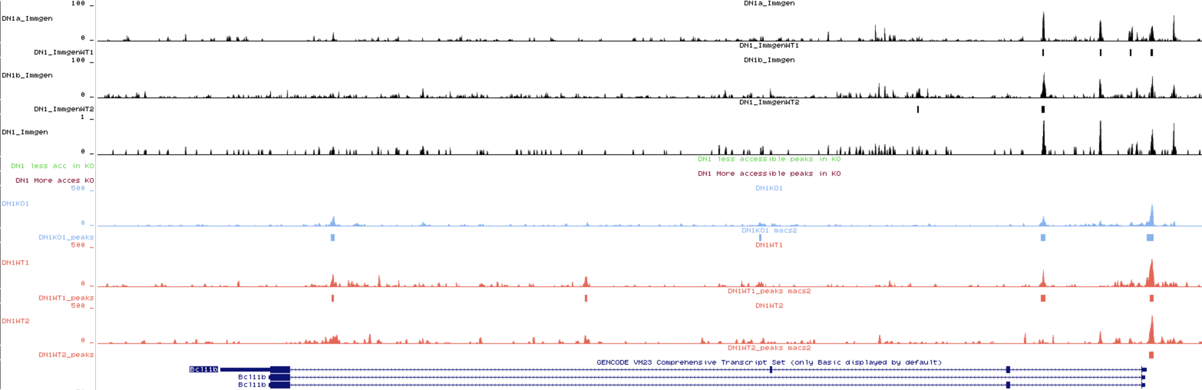
Bcl11b

Slide 18
Overlap Immgen Replicates
64% of WT1 overlaps with WT2
88% of WT2 overlaps with WT1

Slide 19
Overlap Immgen and OP9 peaks
DN1 peaks OP9 co-culture
DN1 peaks Immgen
40% of Immgen peaks overlap with the OP9 DN1 peaks
81% of OP9 peaks overlap with the Immgen peaks
The OP9 ATAC-seq detects less peaks than the Immgen DN1 but most of them are overlap. With our dataset we might be missing some change in accessibility at certain loci.

Slide 20
Number of Peaks
2046
Motif analysis
269
37473
28992
24902
58065
Differential peaks are mostly found away from the gene promoters
42861

Slide 21
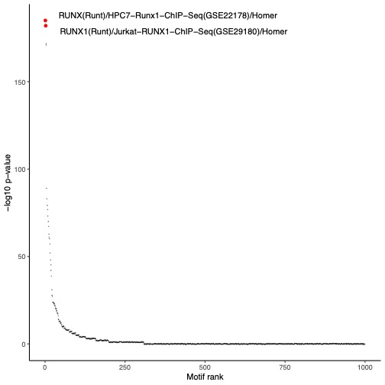
2046 LESS accessible loci in the mutant compared to the WT

Slide 22
269 MORE accessible loci in the mutant compared to the WT

Slide 23
Runx1 motif: CWAACCACAR
Occurrence genome-wide :85689
Overlap with Less accessible peaks: 338 (17%)
Runx1 Motif less accessible (338)
Runx1 Motif less random loci
Runx1 motif are more accessible in WT than in mutant. Also true from Immgen

Slide 24
Tcf7 motif: CCACATCAAAGG
Occurrence genome-wide : 70110
Overlap with Less accessible peaks: 197 (10%)
Tcf7 Motif less accessible (197)
Tcf7 Motif less random

Slide 25
Summary
Despite low coverage, we can identify accessible chromatin in OP-9 ATAC-seq
Most peaks identified are located in promoter region
Identification of Differentially accessible loci (DALs):
2046 are less accessible in the mutant than in WT
269 are more accessible in the mutant than in WT
The motif analysis shows that potential binding sites for important TF regulators of T-cell commitment are impacted
Are those DALs enhancers?
To do: Differential peak analysis between WT OP9 and WT Immgen.

